Slide 1
Building blocks

Slide 2
Deploying applications in the cloud with Heroku Web sockets
Damian Miranda

Slide 3
About me
More than 10 years in the software development industry
Software engineer @ GEIQ
Digital Twin
Time tracking management software
Twitter: @damian_miranda

Slide 4
Getting started with Heroku
Install Heroku CLI:
curl https://cli-assets.heroku.com/install.sh | sh

Slide 5
Getting started with Heroku (Nodejs example)
Initialize a Nodejs application:
npm init
Install express
npm install express --save
Init Git
git init
Create a Profile file
touch Procfile
echo 'web: node index.js' >> Procfile
Create the index.js
touch index.js
Login into Heroku:
heroku login
Create you app:
heroku create
Push your code:
git add
git commit -m ”Initial commit”
git push heroku master

Slide 6
index.js
const http = require('http');
const PORT = process.env.PORT || 5000;
const server = http.createServer((req, res) => {
res.statusCode = 200;
res.setHeader('Content-Type', 'text/plain');
res.end('Hello World\n');
});
server.listen(PORT, () => {
console.log(`Server running on ${PORT}/`);
});

Slide 7
Web sockets

Slide 8
What are web sockets?
The WebSocket protocol enables interaction between a web client (such as a browser) and a web server with lower overheads, facilitating real-time data transfer from and to the server.
This is made possible by providing a standardized way for the server to send content to the client without being first requested by the client, and allowing messages to be passed back and forth while keeping the connection open.

Slide 9
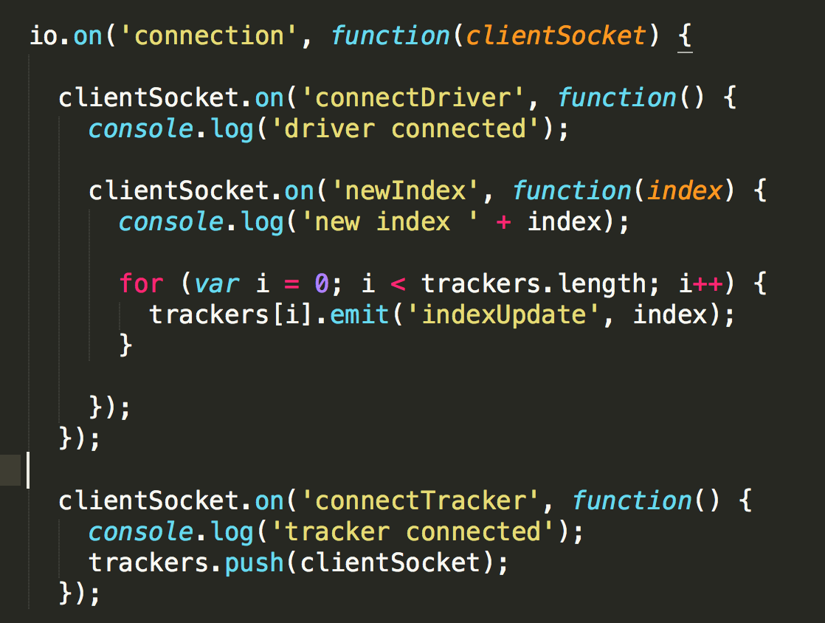
Web sockets server

Slide 10
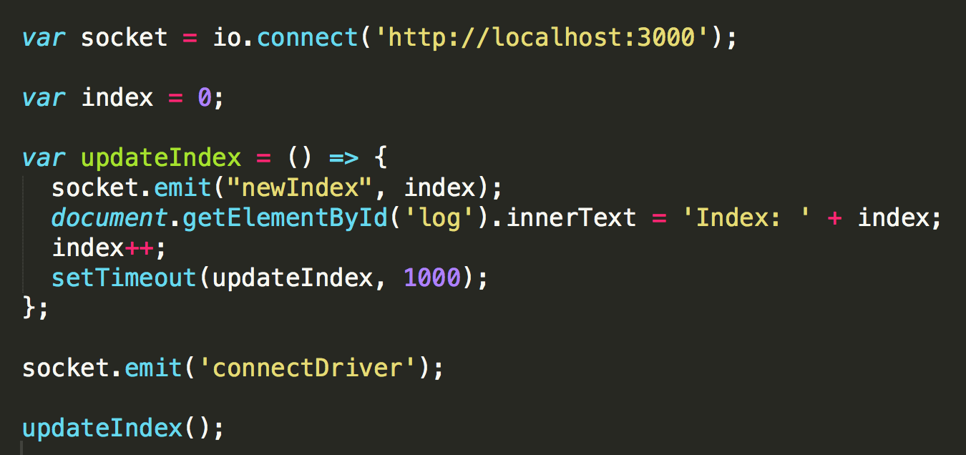
Web sockets client (emitter)

Slide 11
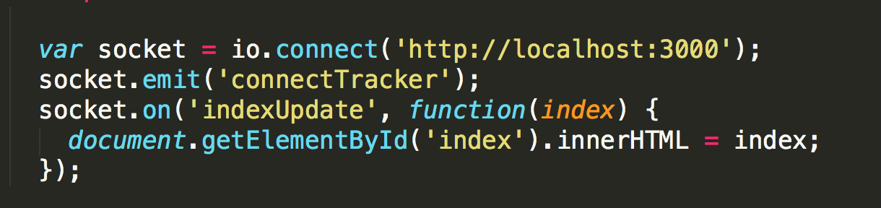
Web sockets client (receiver)

